Slide 1
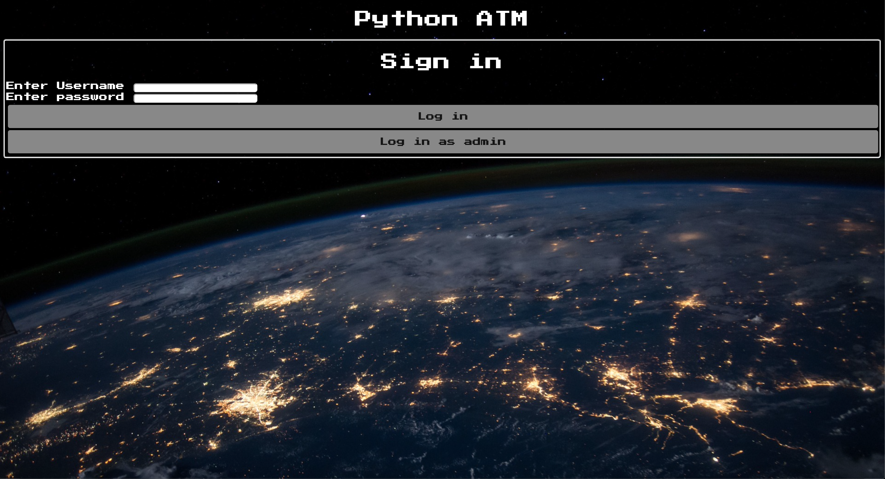
Python ATM
By: Tayler Cooper, Troy Peterson, George Moore, and Kollier Martin

Slide 2
Requirements / User Stories
As a user I would like to be able to login and view my balance so I know how to manage my money.
As a user I would like to be able to transfer money to another account so I can have the ability to disperse money how I like.
As a user I would like to be able to withdraw money from my account so I can readily have access to cash.
As a user I would like to be able to deposit cash or check into my account so I do not have to go to a physical bank.
As a user I would like to be able to temporarily block my card in order to better protect myself financially.
Notes:
George Wil Talk

Slide 3





Design Documentation

Slide 4
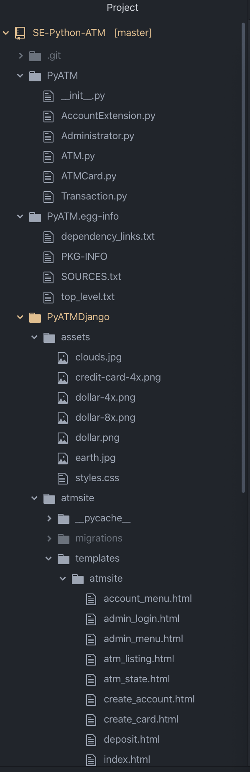
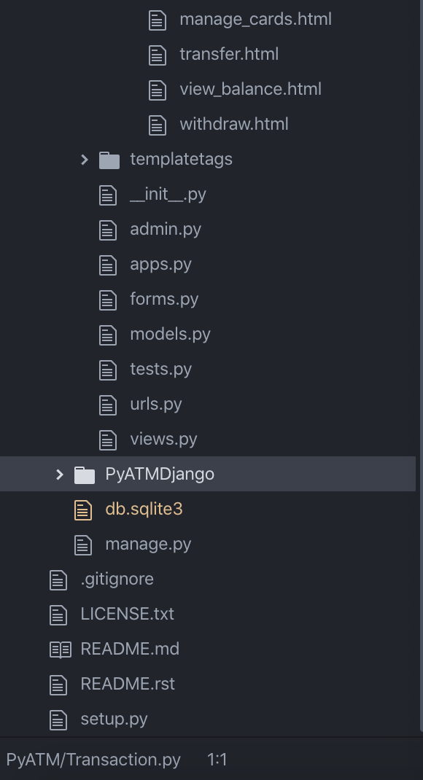
Architecture
PyATM: Holds all Python code
PyATMDjango: Stores assets, includes templates(HTML), and Database(SQL)
Notes:
George

Slide 5
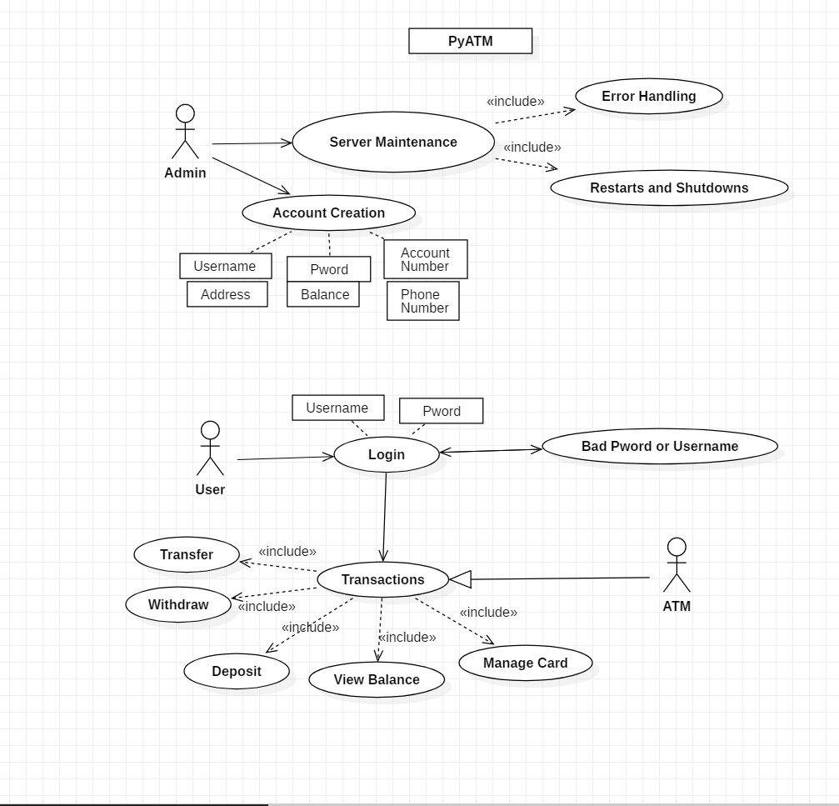
Use Cases
Notes:
Kollier

Slide 6
Structure (Implementation)
Views are written in python, and are functions run when certain URLs are accessed. Views calculate any values that need to be passed on to the html rendering, e.g., who is currently logged in; what is their balance.
In HTML forms, information is sent to a “processing” URL, which doesn’t have an associated html, but instead runs the corresponding view, which grabs the information from the request using POST and modifies related database objects, which are saved to the sqlite3 database.
After processing is performed, the URL redirects to a “presentation” URL that displays the menu.
Notes:
Tayler

Slide 7
Structure (Abstract)
We use HTML that displays the GUI.
Used Django template language that also creates HTML at runtime.
The Django code interacts with the SQL database which stores user information.
Python code serves two purposes:
1. Determines how the ATM will function both backend and frontend
2. Database interaction
Notes:
George

Slide 8
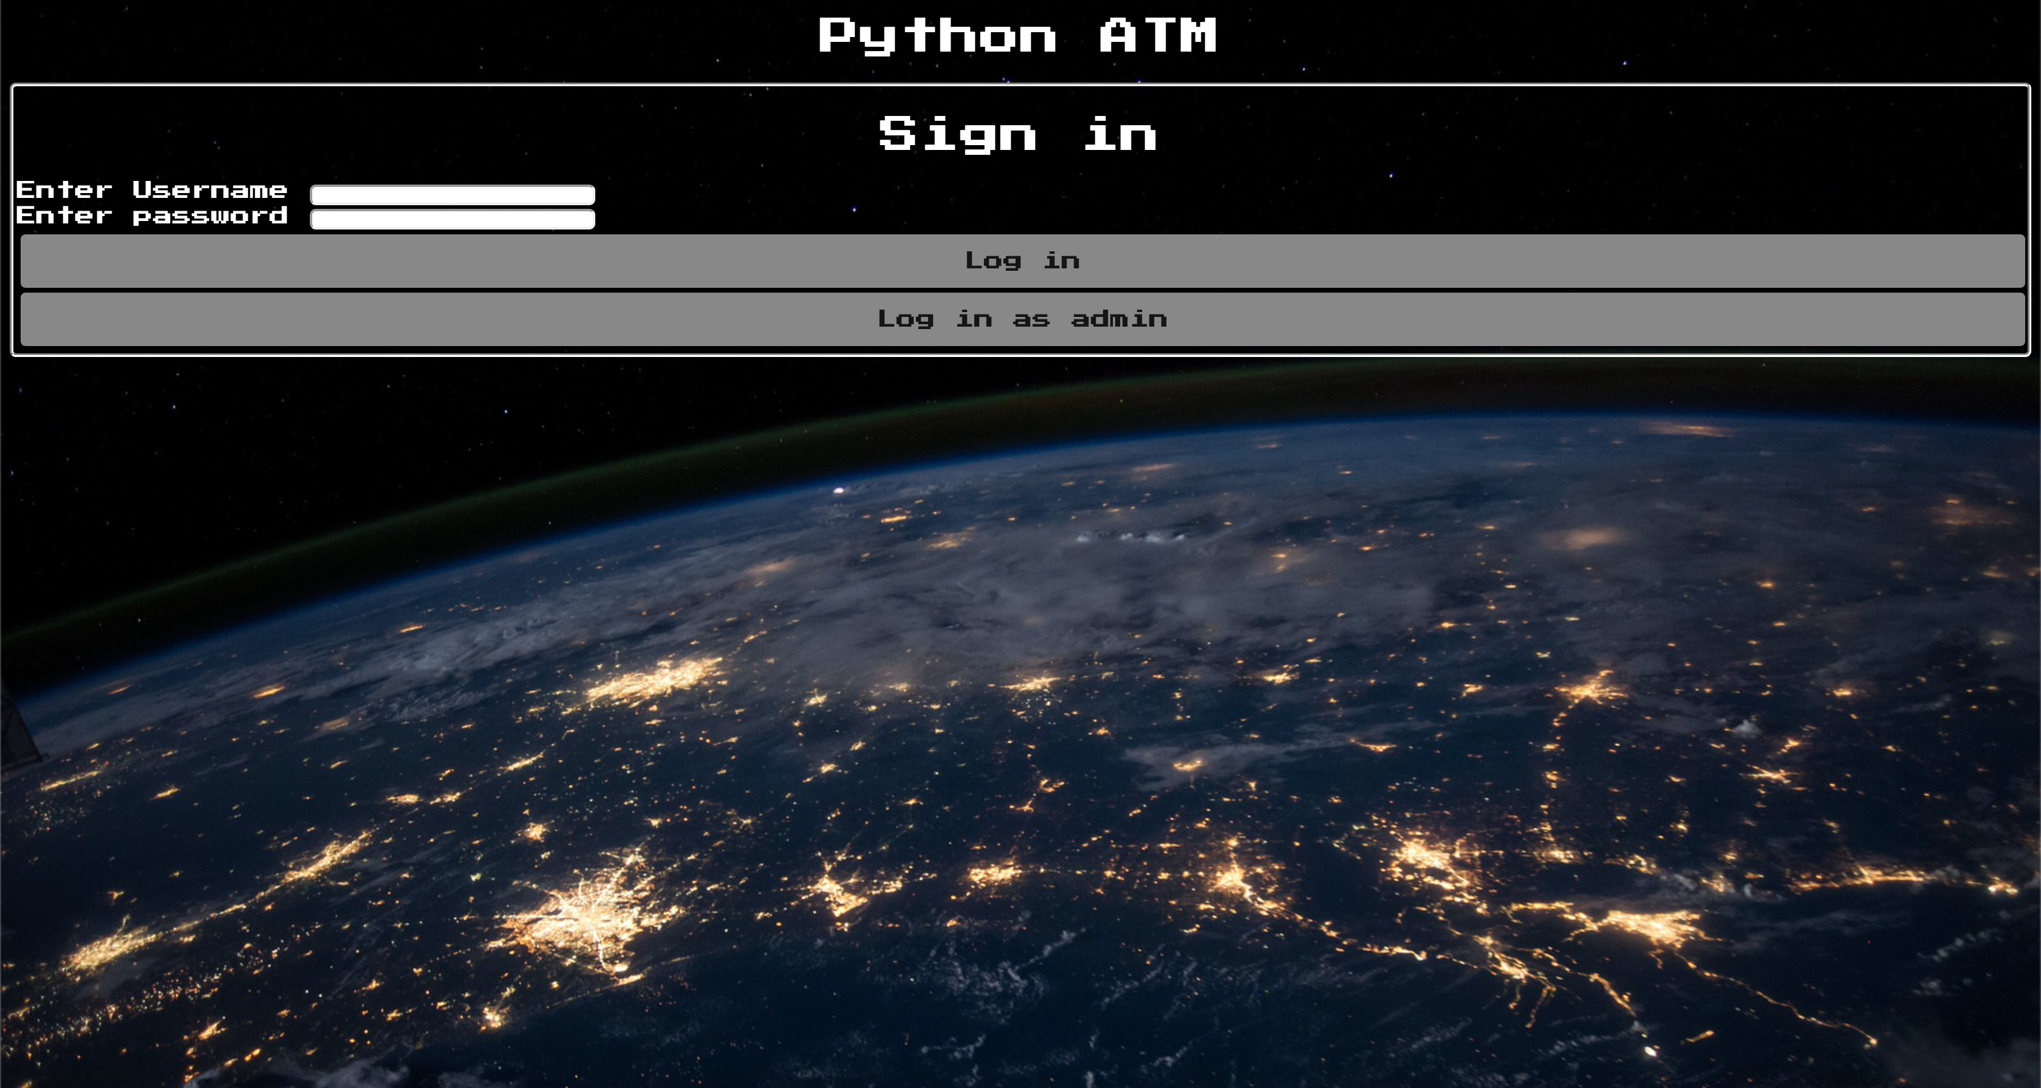
Interfaces
The interface is designed to look like a hybrid between an ATM and a banking site.
Notes:
Troy

Slide 9
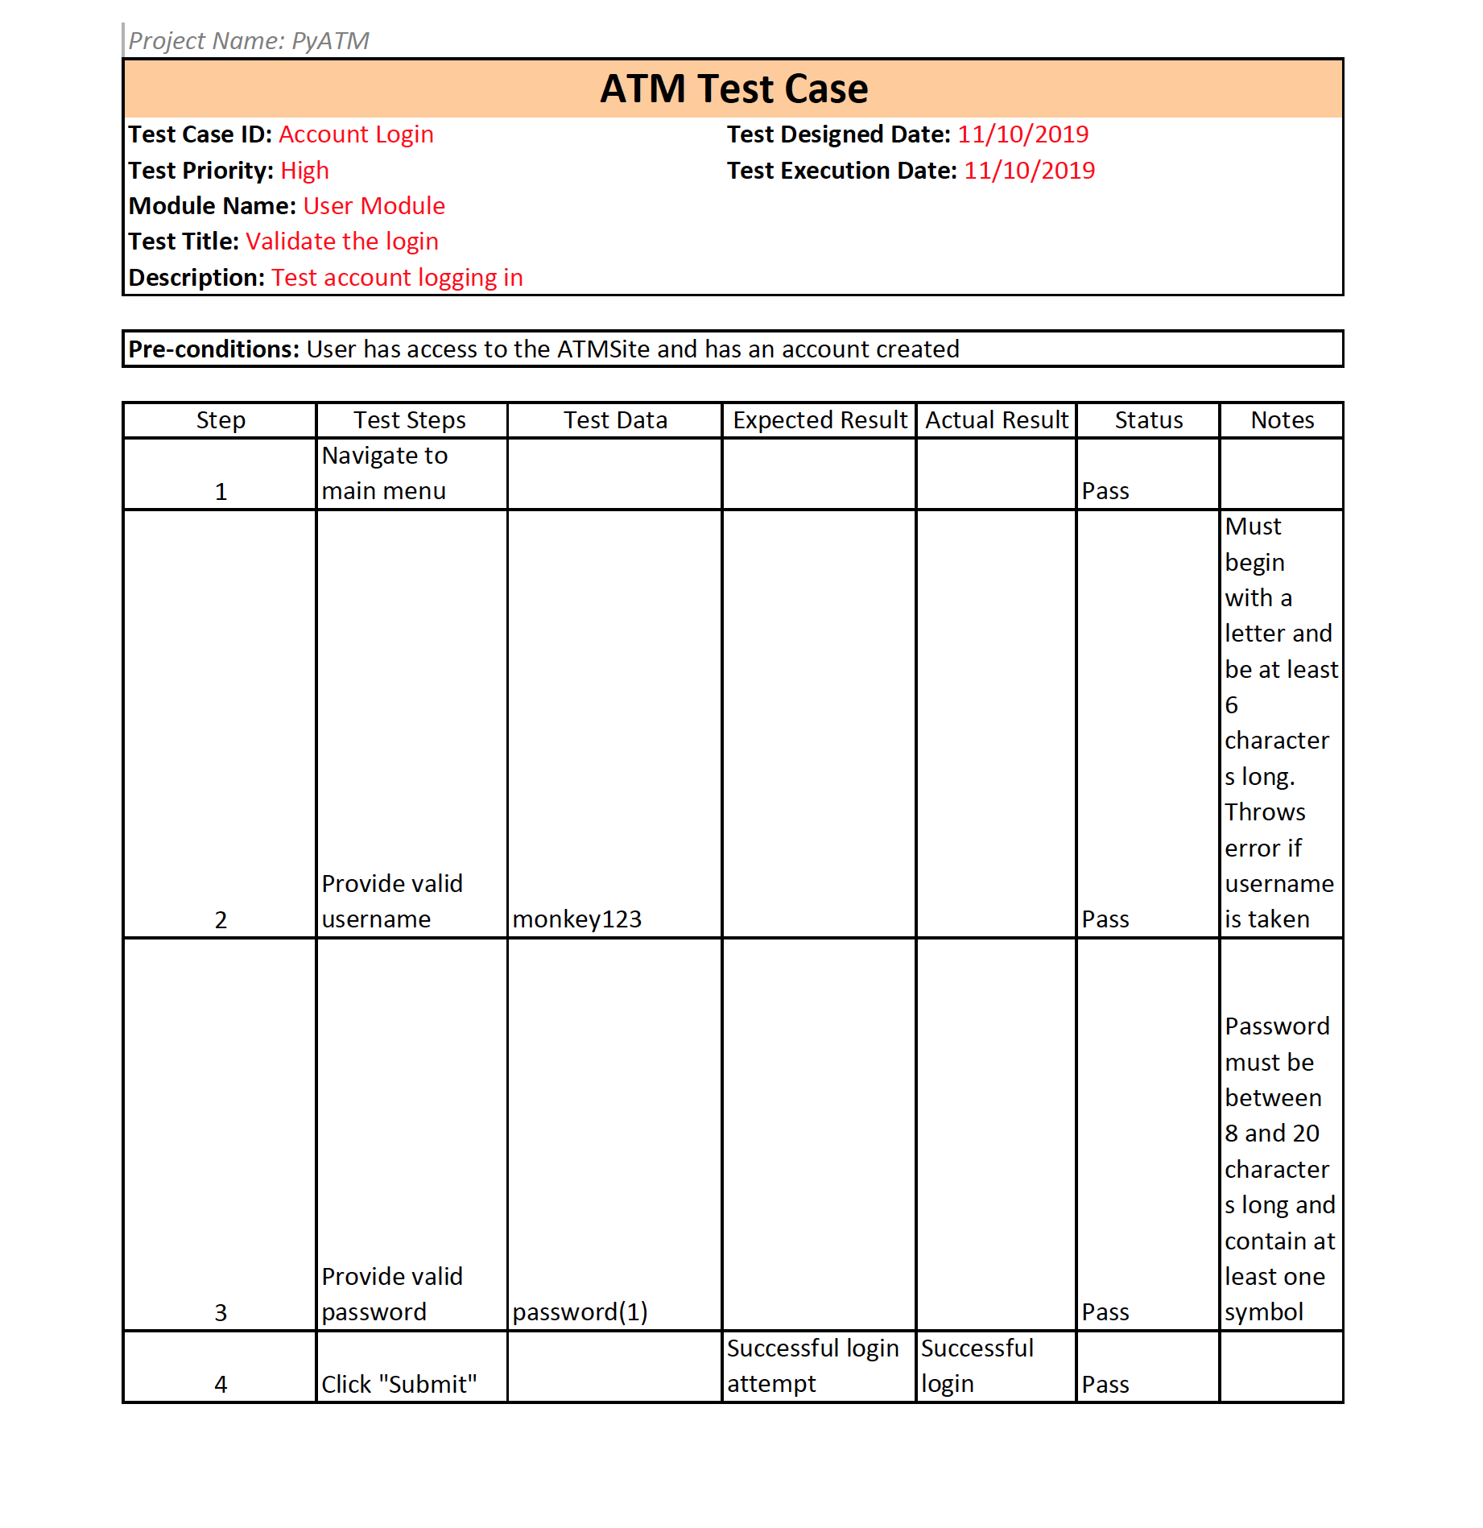
Test Cases
Notes:
Kollier

Slide 10
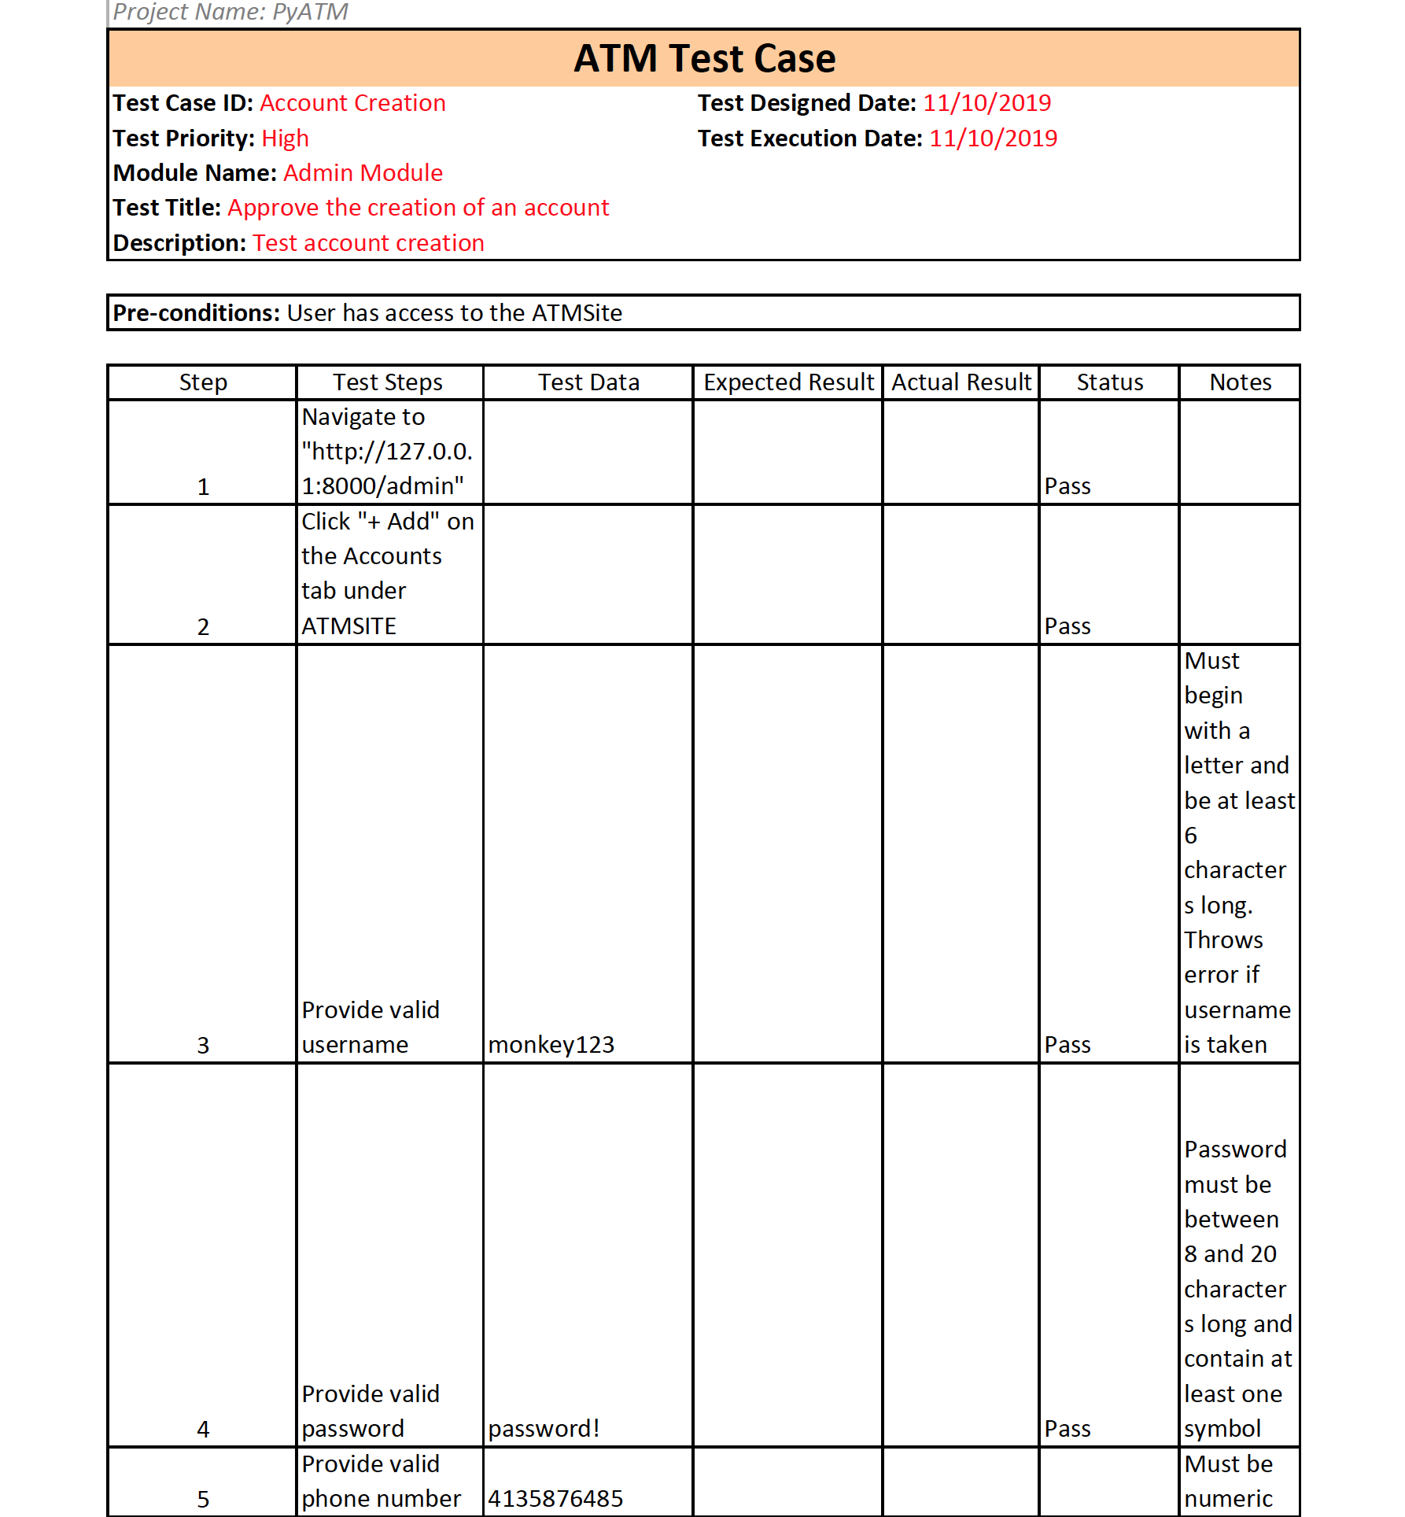
Test Cases (cont.)
Notes:
Kollier

Slide 11

Management Plan
We use the online software ClickUp for Agile development and Git/github for version control
Notes:
George

Slide 12
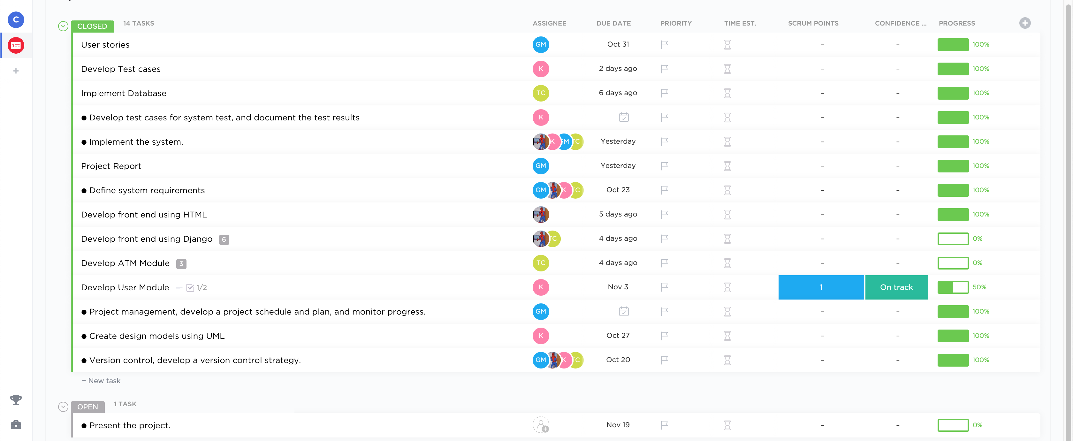
Screenshots
Notes:
George

Slide 13
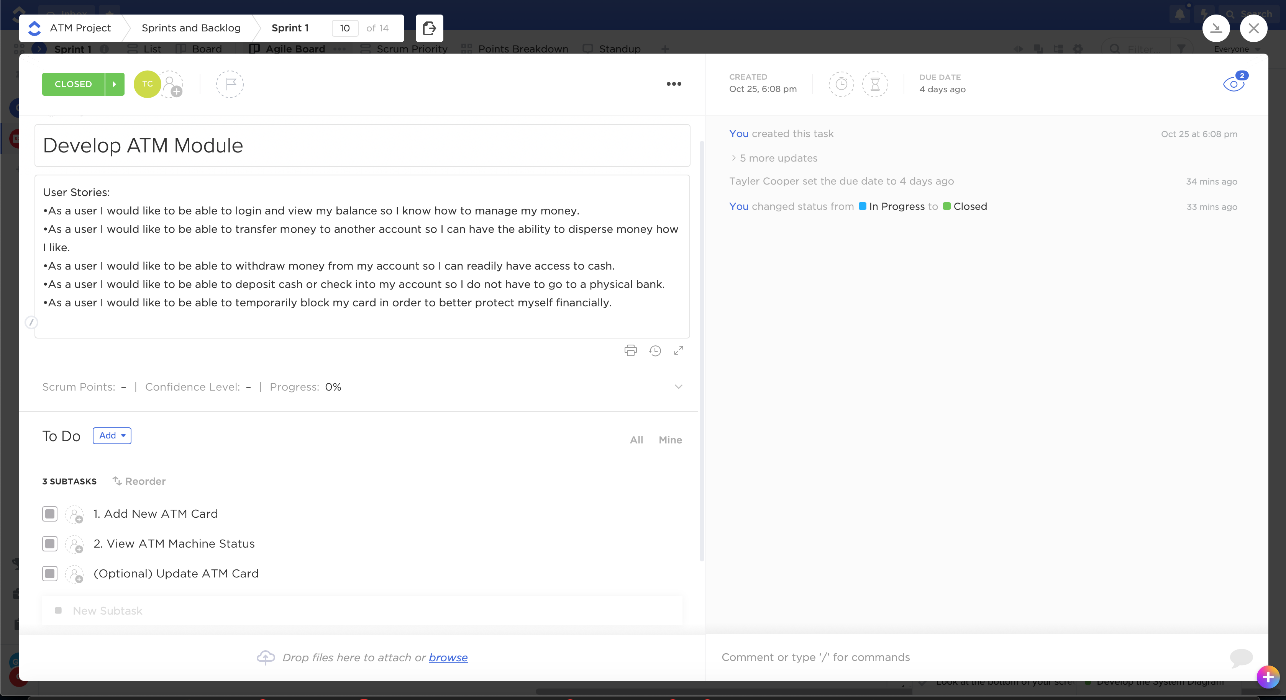
Notes:
George

Slide 14
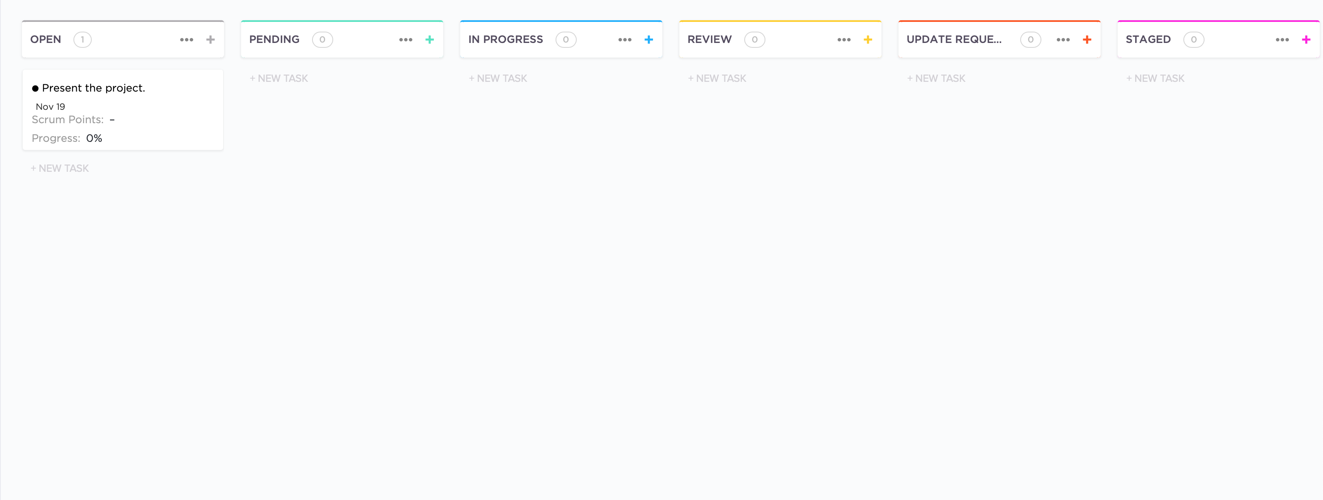
Notes:
George

Slide 15
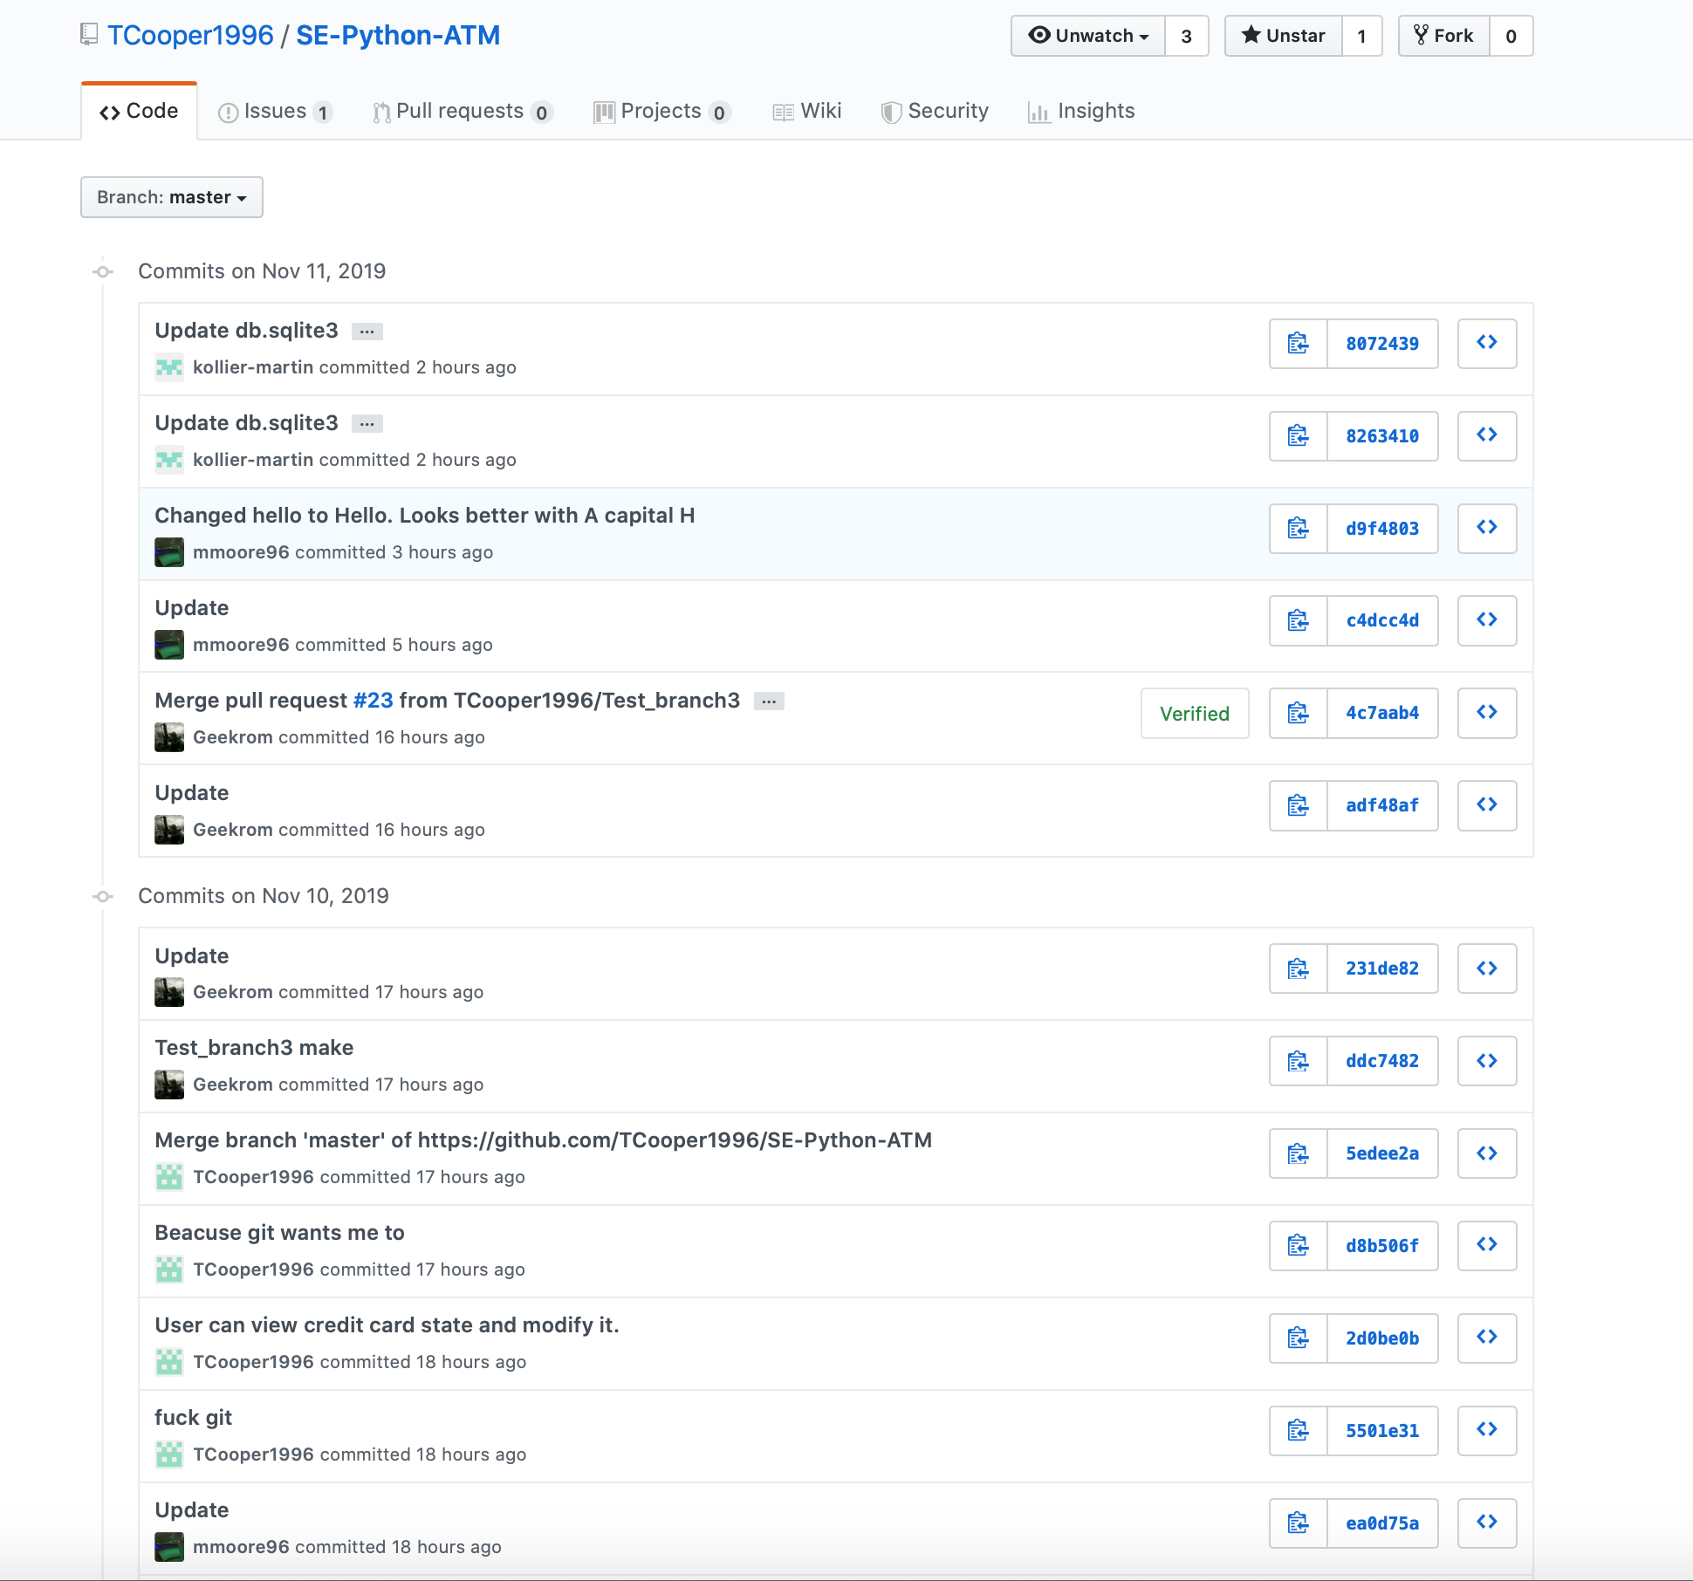

Slide 16
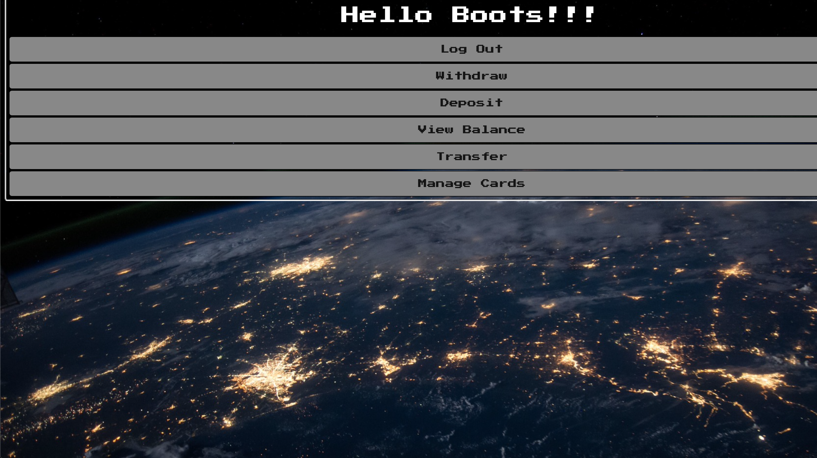
Demo
http://127.0.0.1:8000/atmsite/?
Notes:
Tayler

